Slide 1



以太坊源码解析 - Account
郑嘉文
2018/03/31

Slide 2
前言/PREFACE
不知不觉间，来到学堂在线这个大家庭已经有1年多的时间了。在这段时间的工作中，我收获了很多开发中的很多经验，也吸取了一些工作中的教训。接下来我把一年来的工作情况总结如下：

Slide 3
目录/Contents
01
预备知识
02
Keystore
03
ABI

Slide 4
01
预备知识

Slide 5

Key/Address

Slide 6


私钥(Private Key)
范围
[1, n – 1] n = 1.158 * 10^77
注意
不要自己生成私钥。要使用cryptographically secure pseudo-random number generator (CSPRNG)
例子
1E99423A4ED27608A15A2616A2B0E9E52CED330AC530EDCC32C8FFC6A526AEDD
256 bit

Slide 7
公钥(Public Key)
Bitcoin uses a specific elliptic curve and set of mathematical constants, as defined in a standard called secp256k1, established by the National Institute of Standards and Technology (NIST).
The secp256k1 curve is defined by the following function, which
produces an elliptic curve:
y^2 = x^3 + 7 over p
or
Y^2 mod p = x^3 + 7 mod p
p ：prime number

Slide 8
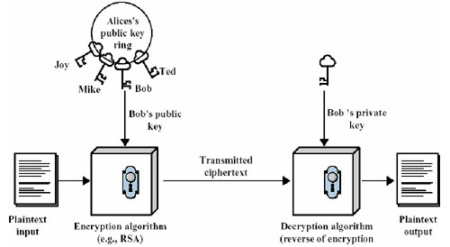
基于公开密钥的加密

Slide 9
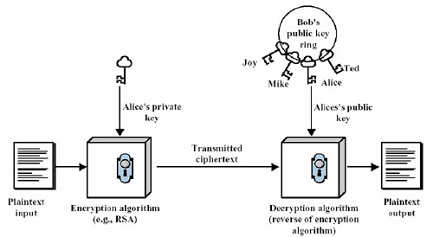
基于公开密钥的认证

Slide 10
地址(Address)
公式
A = RIPEMD160 (SHA256( K))
长度 160bit = 20 Byte
例子
1J7mdg5rbQyUHENYdx39WVWK7fsLpEoXZy
使用地址来接收和发送资金，地址采用Base58Check编码
BIP-38 proposes a common standard for encrypting private keys with a passphrase and encoding them with Base58Check so that they can be stored securely on backup media, transported securely between wallets, or kept in any other conditions where the key might be exposed.

Slide 11
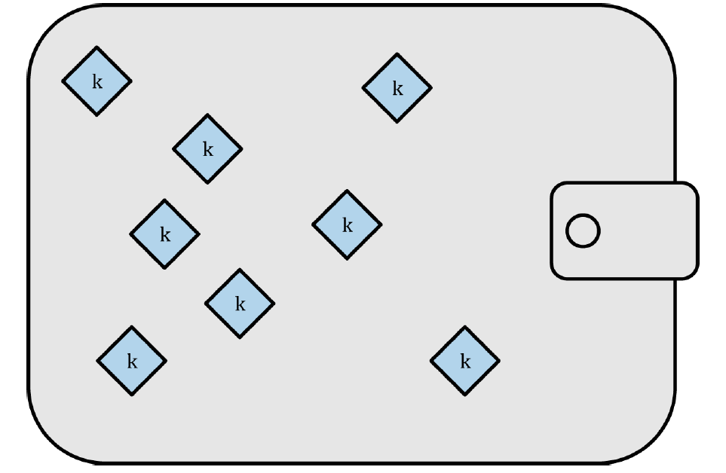
Nondeterministic (Random) Wallets

Slide 12
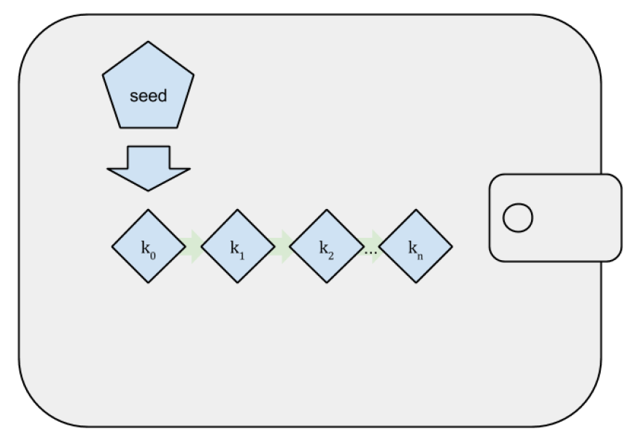
Deterministic (Seeded) Wallets

Slide 13
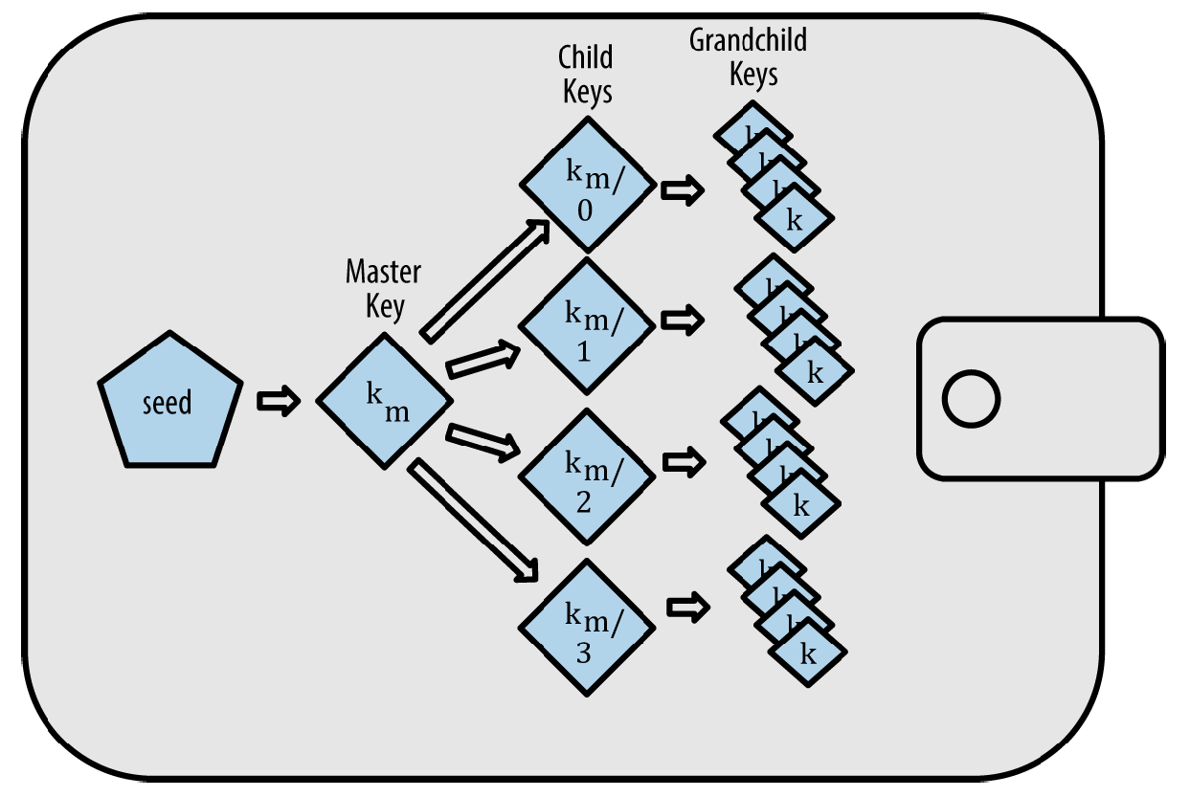
HD Wallets(BIP-32/BIP-44)

Slide 14
Seeds and Mnemonic Codes (BIP-39)
例子
0C1E24E5917779D297E14D45F14E1A1A
army van defense carry jealous true
garbage claim echo media make crunch
Wallet Best Practice
• Mnemonic code words, based on BIP-39
• HD wallets, based on BIP-32
• Multipurpose HD wallet structure, based on BIP-43
• Multicurrency and multiaccount wallets, based on BIP-44

Slide 15
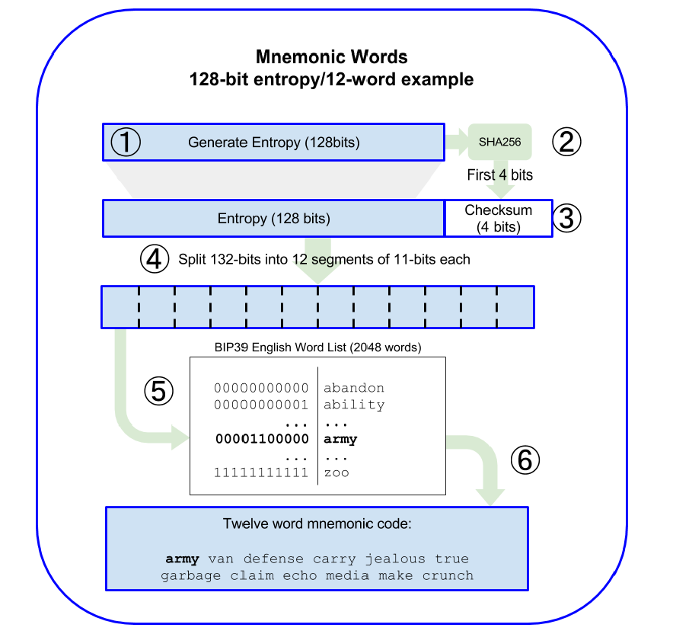
Seeds and Mnemonic Codes (BIP-39)

Slide 16
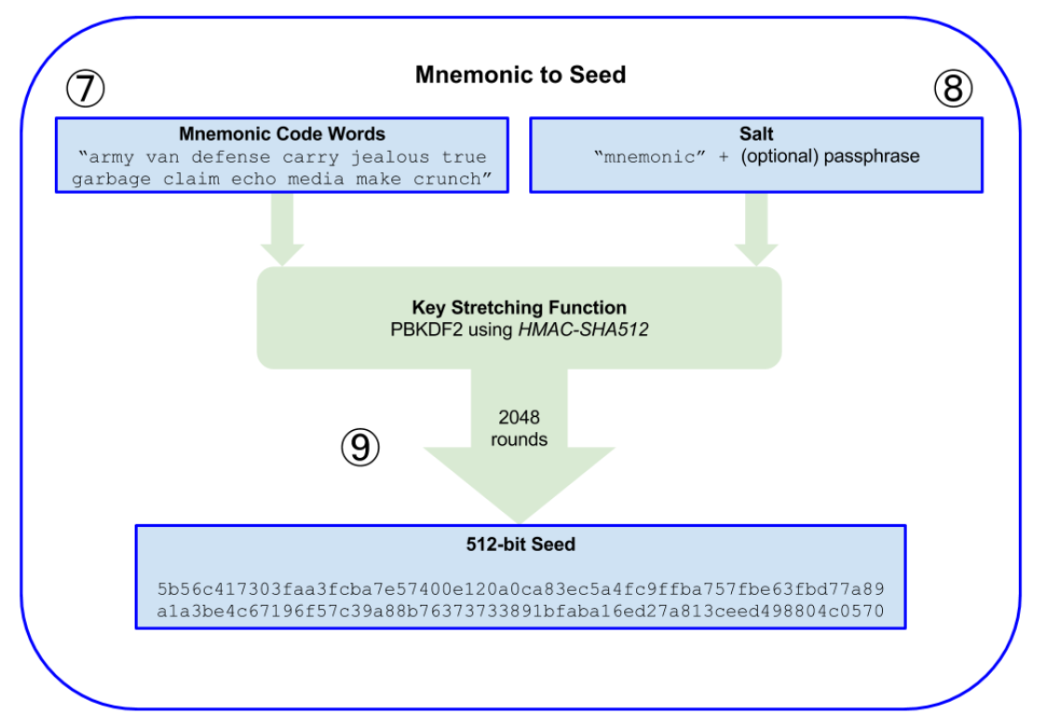
From mnemonic to seed

Slide 17
02
KeyStore

Slide 18
工作中存在的问题
思考问题不够全面
主要体现在功能开发上，有些代码重复性很高。在之后在开发之前更全面的思考代码的复用性。同时应当更多的思考异常的处理方式
主要问题
沟通上存在不足
主要体现在最近的几次线上事故中。事故发生后总结发现完全可以通过充分的沟通来避免此类问题。今后会继续改进
解决问题信心不足
主要体现在专业版部署的技术方案提供上。在面对部署上的技术条件限制问题时自信心不足，经常担心无法提供有效的方案，不敢试错。

Slide 19
03
ABI（Application Binary Interface）

Slide 20
ABI
When using the JavaScript dapp API, calling a contract via an abstraction layer such as the eth.contract() function will send back an object with all the functions that contract can run when called in JavaScript. To standardize this introspective functionality, the Ethereum protocol comes with something called the application binary interface, otherwise known as the Contract ABI. The ABI behaves like an API, creating a standard syntax for contracts to be called by applications. The ABI dictates that the contract will send back an array that delineates the proper call signature and the available contract functions.
-- https://github.com/ethereum/wiki/wiki/Ethereum-Contract-ABI#functions
Strong Type
No Introspection
Know At Compilation
Static

Slide 21
Function Selector
The first four bytes of the call data for a function call specifies the function to be called. It is the first (left, high-order in big-endian) four bytes of the Keccak (SHA-3) hash of the signature of the function.
Strong Type
No Introspection
Know At Compilation
Static

Slide 22
Function Selector
pragma solidity ^0.4.16;
contract Foo {
function bar(bytes3[2]) public pure {}
function baz(uint32 x, bool y) public pure returns (bool r) { r = x > 32 || y; }
function sam(bytes, bool, uint[]) public pure {}
}
如果以参数69 and true 调用 baz(), 我们会传送 68 bytes：
0xcdcd77c000000000000000000000000000000000000000000000000000000000000000450000000000000000000000000000000000000000000000000000000000000001
值（Value） | 详细（Detail）
0xcdcd77c0 | the Method ID This is derived as the first 4 bytes of the Keccak hash of the ASCII form of the signature baz(uint32,bool)
0x0000000000000000000000000000000000000000000000000000000000000045 | the first parameter, a uint32 value 69 padded to 32 bytes
0x0000000000000000000000000000000000000000000000000000000000000001 | the second parameter - boolean true, padded to 32 bytes

Slide 23
Function Selector – Dynamic Type
A call to a function with the signature f(uint,uint32[],bytes10,bytes) with values (0x123, [0x456, 0x789], "1234567890", "Hello, world!")
编码结果：
0x8be65246 0000000000000000000000000000000000000000000000000000000000000123 0000000000000000000000000000000000000000000000000000000000000080 3132333435363738393000000000000000000000000000000000000000000000 00000000000000000000000000000000000000000000000000000000000000e0 0000000000000000000000000000000000000000000000000000000000000002 0000000000000000000000000000000000000000000000000000000000000456 0000000000000000000000000000000000000000000000000000000000000789 000000000000000000000000000000000000000000000000000000000000000d 48656c6c6f2c20776f726c642100000000000000000000000000000000000000

Slide 24
谢谢聆听
郑嘉文
2018/03

